Slide 1

SMART INDIA HACKATHON 2026
GUARDIANS
SEE | TRACE | PROTECT OUR OCEANS
Problem Statement ID : 26143
Problem Statement Title
Leveraging satellite imagery to determine oil spills at sea along with AIS data correlations to identify the vessel responsible for the spill
Theme : Disaster Management
PS Category: Software
Team ID: BMS/SIH2026/124
Team Name: Who Spilled it

Slide 2
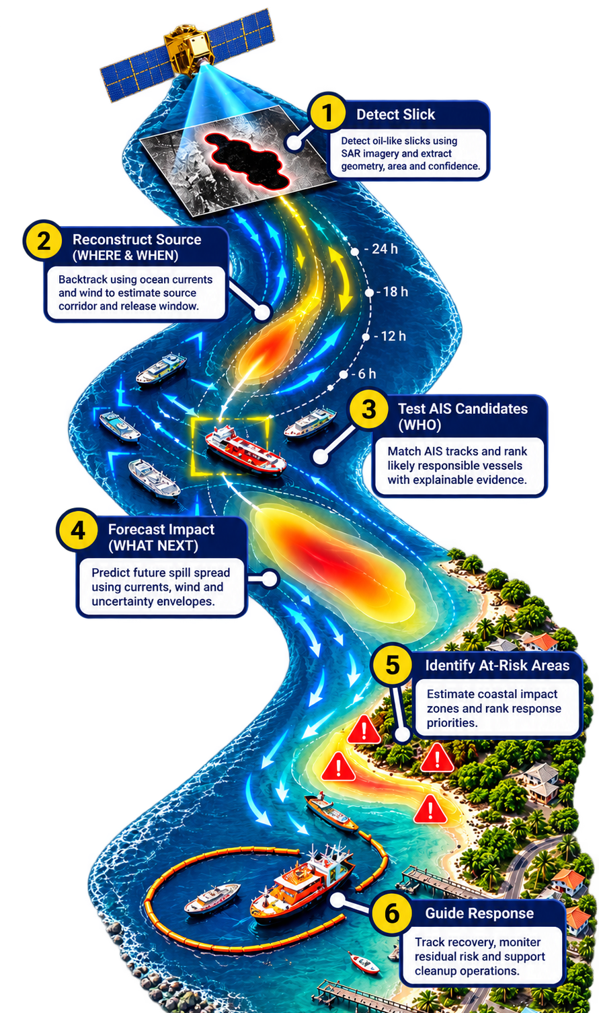






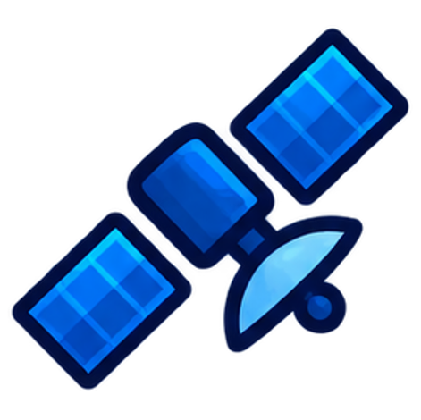

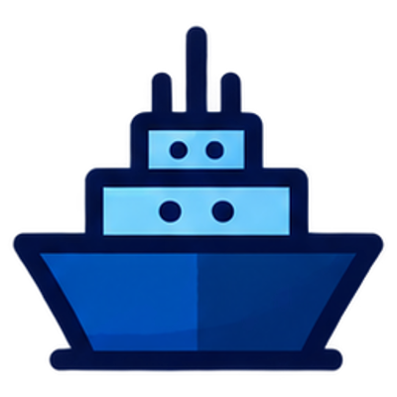

Proposed Solution
Guardians
Who Spilled It
Real World Problem
Architecture Diagram
Hard to detect oil early
Easily confused with look-alikes
Hard to find the source
Current and winds move oil.
Delay increases damage
Current and winds move oil.
Need source accountability
Enables faster response, accountability
Our Solution – ‘Guardians’
Detects & validates oil spills
Distinguishes potential spills from look-alikes.
Uniqueness and Innovation
Backtracks spill movement
Estimates WHERE and WHEN it originated using ocean currents, wind, etc.
Realistic physics model with both past and future forecast
Reproducible forecast with uncertainty-aware conclusions and a traceable evidence chain.
Identifies potential source vessels
Matches historic AIS tracks to source.
Lightweight ResNet-18 enables efficient inference and edge-device deployment.
Forecasts future spill movement
Predicts WHERE the spill may go next to
support faster response and cleanup planning
Modular architecture enables independent, parallel execution of analysis modules.
@SIH Idea submission- Template

Slide 3
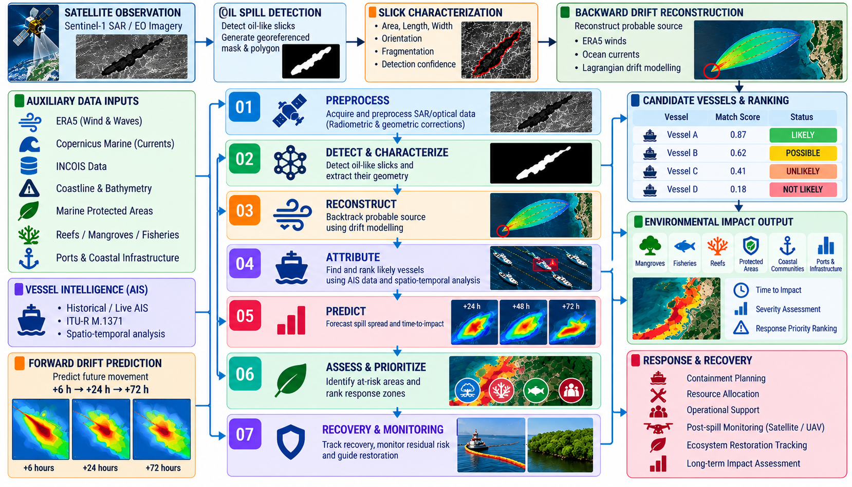
Who Spilled It
Technical Approach
@SIH Idea submission- Template

Slide 4
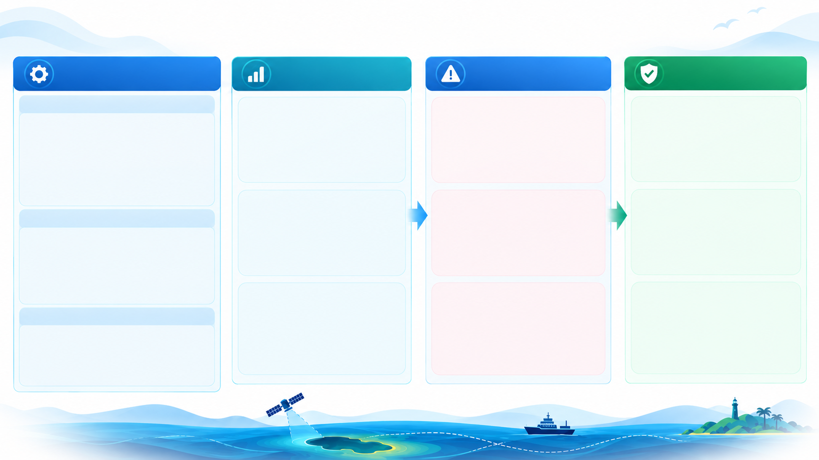
Who Spilled It
Feasibility and Viability

Slide 5
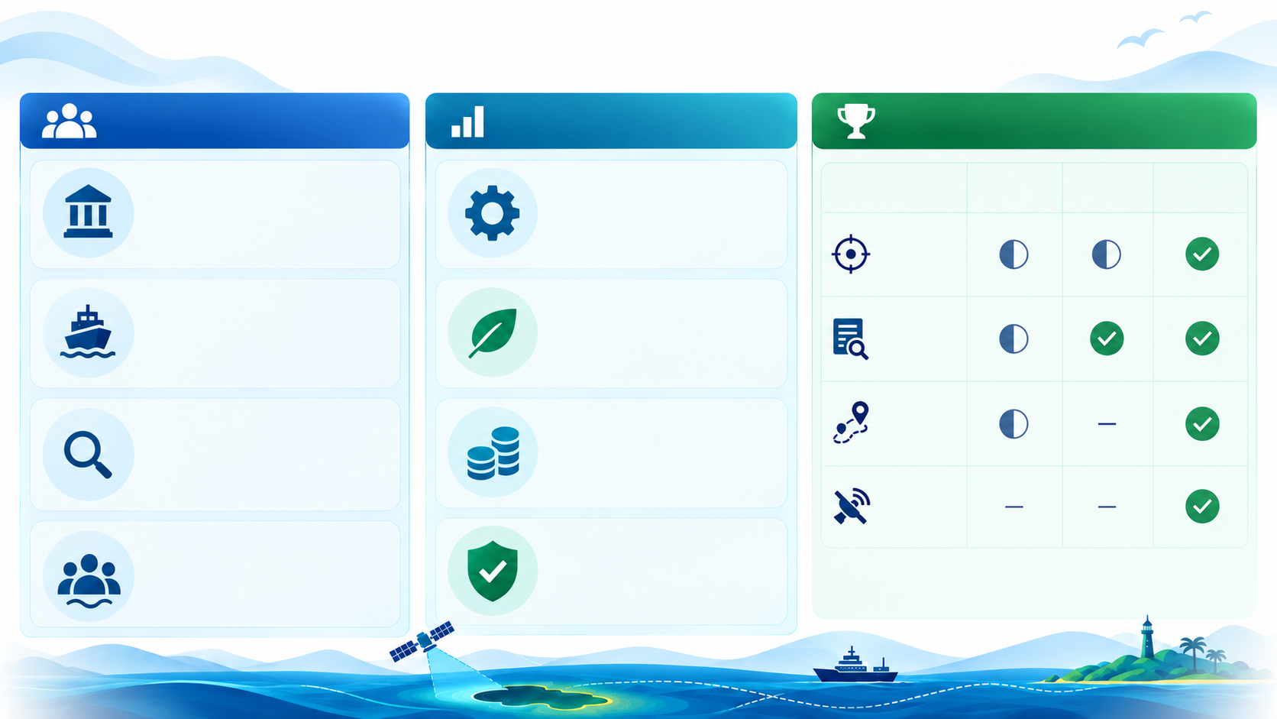
Who Spilled It
Impacts and Benefits
Who Benefits
Value Created
Why “GUARDIANS”
Maritime Authorities
Faster incident assessment and source investigation.
Operation
Faster incident assessment and source investigation.
Response Teams
Better prioritization of containment, surveillance, and cleanup zones.
Response Teams
Better prioritization of containment, surveillance, and cleanup zones.
Investigators
Evidence-based vessel screening with traceable attribution logic.
Investigators
Evidence-based vessel screening with traceable attribution logic.
Coastal Communities
Earlier warning of areas likely to be affected.
Coastal Communities
Earlier warning of areas likely to be affected.

Slide 6
Who Spilled It
Research and References
Data sources
Sentinel-1 / Satellite
https://dataspace.copernicus.eu/data-collections/copernicus-sentinel-missions/sentinel-1
https://dataspace.copernicus.eu/
https://sentinels.copernicus.eu/sentinel-data-access
Sentinel-1 Oil Spill Datasets
https://zenodo.org/records/8346860
Weather / Wind
https://cds.climate.copernicus.eu/datasets/
Ocean Currents / Marine Data
https://data.marine.copernicus.eu/
INCOIS
https://www.incois.gov.in/
AIS / Vessel Data
https://ocmgeodatastor1.blob.core.windows.net/marinecadastre/ais/aistrack/index-aistrack.html
https://www.fisheries.noaa.gov/inport/item/79504
https://globalfishingwatch.org/our-apis/
Environmental Impact Layers
https://www.protectedplanet.net/en/thematic-areas/wdpa
https://allencoralatlas.org/resources/
https://resources.unep-wcmc.org/products/aaa46cd3d3d640b2916b8f0a0ffe07cb
https://www.naturalearthdata.com/downloads/10m-physical-vectors/
https://www.naturalearthdata.com/downloads/10m-physical-vectors/10m-coastline/
https://response.restoration.noaa.gov/esi
https://www.fisheries.noaa.gov/inport/item/40881
Papers / Methods
https://www.sciencedirect.com/science/article/pii/S0025326X24005265
https://pubmed.ncbi.nlm.nih.gov/38850755/
https://openaccess.thecvf.com/content_ECCV_2018/html/Liang-Chieh_Chen_Encoder-Decoder_with_Atrous_ECCV_2018_paper.html
https://openaccess.thecvf.com/content/ICCV2025/html/Jakubik_TerraMind_Large-Scale_Generative_Multimodality_for_Earth_Observation_ICCV_2025_paper.html
https://arxiv.org/abs/2504.11171
https://opendrift.github.io/
https://github.com/OpenDrift/opendrift
https://www.itu.int/rec/R-REC-M.1371
https://essd.copernicus.org/articles/17/6807/2025/
https://zenodo.org/records/3497132
https://doi.org/10.3390/rs11151762
https://zenodo.org/records/2541694

